Slide 1
529 Data Analytics
October 20, 2016
Analysis of Personal Income
Aishwarya Ravi, Hong Zhang

Slide 2
Table of Content
Business Scenario and Objectives
Data Selection and Cleansing
Exploratory Data Analysis Results
Basic Statistics for Continuous Variables
Association between response and predictor
Statistics for Categorical Variables
Association between response and predictor
Regression Modeling Results
Linear Regression Modelling Results
Exploratory Data Analysis Results
bonus (income >= $56,210)
Regression Modeling Results
Logistic Regression Modeling Results
Exploratory Data Analysis Results
high_bonus (income >= $112,420)
Regression Modeling Results
Logistic Regression Modeling Results
Conclusions

Slide 3

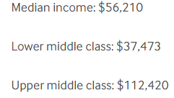
Business Scenario and Objectives
Business Scenario:
Everybody care about the same question how I can earn more money. "Success is a learnable skill," emphasizes T. Harv Eker in his book "Secrets of the Millionaire Mind." If you want to learn how to get rich — how to grow and master your money — consider these variables which can affect your income. If you want to be one person in Median income or upper middle class? What should I do?
Objectives:
Which of the predictor variables are most decisive in determining the person’s income?
Am I more likely to make more than $56,210 if I am a Manager or specialist?
What are top 3 degrees more likely to get income> $56,210 or $112,420 ?
What are top 3 Occupations more likely to get income> $56,210 or $112,420 ?

Slide 4
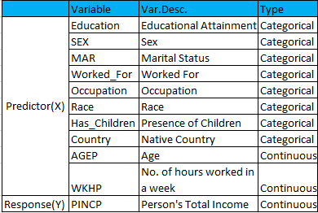
Selected Data and Data Cleansing Understanding of data set
The data set contains the data of American Community Survey 2010-2014 ACS 5-year PUMS.
http://www.census.gov/programs-surveys/acs/data/pums.html
File name: psam_p17.sas7bdat
Row Count: 635532
Time Period: 2010-2014
Data set has 293 variables out of which
10 variables are considered for analysis.
Data Cleansing:
Used ADJINC(Adjustment factor
for income and earnings dollar amounts
to get current PINCP(Income).
PINCP=PINCP*(ADJINC/1000000)
Created two variables “bonus” for Median Income = $56,210 and “high_bonus” for Upper Middle Class= $112,420.
Deleted Age <= 16, WKHP <= 0 and Income <= $100.

Slide 5
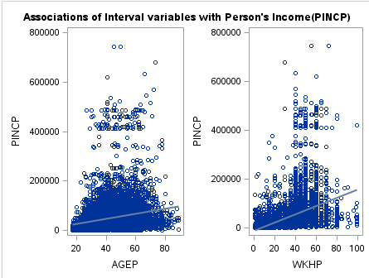

Exploratory Data Analysis Basic statistics for Continuous Variables
The relationship between Income and WKHP has a better linear relationship when compared to AGEP, because it has a better R-square value (0.124) and p<0.05 which rejects null hypothesis i.e. slope is not horizontal.
AGEP shows a little bit association with the person's income but, still there is no much significance in their relationship.

Slide 6
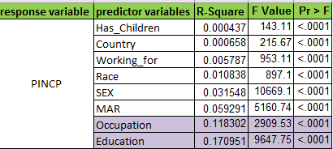
Exploratory Data Analysis Association between response and predictors
The below 8 categorical variables were used to determine their impact on a person’s income.
Occupation and Education have better influence in determining the person’s income. R-square value of Occupation = 0.11; R-square value of Education = 0.17.
Whereas, Has_Children, Country, Working_For and Race have nearly R-square (0) impact on income. Hence, these variables are not a significant predictor.
Sex and MAR(Marital Status) individually shows bit low variability in person’s income with R-square values of 0.03 and 0.06 respectively.
So, for further analysis we are considering Occupation and Education variables.

Slide 7
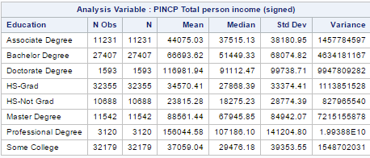
Exploratory Data Analysis Statistics for categorical variables
Also, mean of person’s income is highest for person with professional degree and lowest for a HS-Not Graduate. So maximum income is for person with a professional degree.

Slide 8
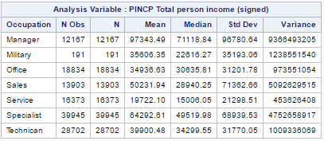
Exploratory Data Analysis Statistics for categorical variables
Mean of person’s income is highest for Manager and lowest for Service. So maximum income is for person who is a manager.
8

Slide 9
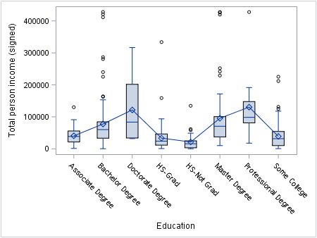
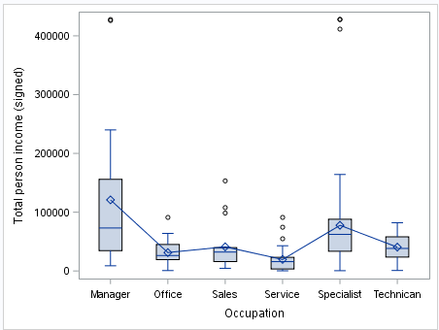
Exploratory Data Analysis Association between response and predictors
Education VS Income shows that Professional Degree has high income i.e. above $150,000 whereas HS-Not Grad has very low income.
Occupation VS Income shows Manager has high income whereas Service has very low Income.
Overall there is statistically significant difference in means of each group of Education and Occupation so both factors have better association with person’s Income.

Slide 10
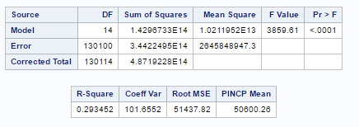
Linear Regression Modeling Results WKHP*Education*Occupation vs Income
Overall, Education, Occupation and WKHP factors have better influence on Income as they explains 17% ,12% and 12% of variability respectively from the exploratory analysis.
Overall interaction of WKHP*Education*Occupation shows 30% of variability in Income i.e. these variables together shows more influence on Person’s Income change. It means for any Occupation/Education, if number of hours worked(WKHP) fluctuates then accordingly Person’s Income will change and that variation in Income is more influenced by combined effect of these 3 factors rather than individual effect as these factors are correlated to each other.

Slide 11
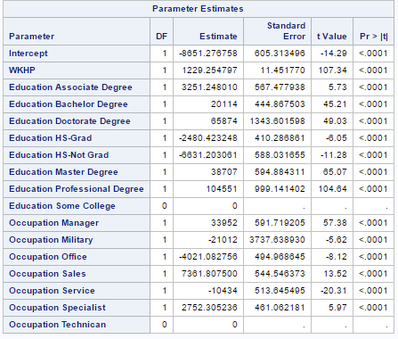
Linear Regression Modeling Results
The constant is -8651.2 when Education: Some college and Occupation: Technician is 0.

Slide 12
Linear Regression Modeling Results
Regression Equation to Predict Person’s Income:
Person's Income = -8651.27 + 1229.25 * WKHP + 3251.24 * Associate +
20114 * Bachelors + 65874 * Doctorate + (-2480.4) * HS-Grad +
(-6631) * HS_Not Grad + 38707 * Masters +104551 * Professional +
33952 * Manager + (-21012) * Military + (-4021) * Office + 7361.8 * Sales +
(-10434) * Service + 2752.3 * Specialist
For instance, WKHP = 40, Education = Masters and Occupation = Manager, then Person’s Income is calculates as :
Person's Income = -8651.27 + 1229.25 * 40 + 38707 + 33952 = $113,175.73
For instance, WKHP = 20, Education = Masters and Occupation = Sales, then Person’s Income is calculates as :
Person's Income = -8651.27 + 1229.25 * 20 + 38707 + 7361.8 = $620,02.53

Slide 13
Exploratory Data Analysis Results: bonus (income >= $56,210)
Bonus is a variable created to analyze if Income > Median Income then bonus eligible. Run Pearson chi-square test to examine whether there is an association between categorical variables and bonus (income >= $56,210 (Median Income)).
Because the p-values of these variables for the chi-square statistic are <.0001, which is below 0.05, reject the null hypothesis at the 0.05 level and conclude that there is evidence of an association between these variables and bonus.
Cramer’s V indicates that the association detected with the chi-square test is relatively weak.

Slide 14
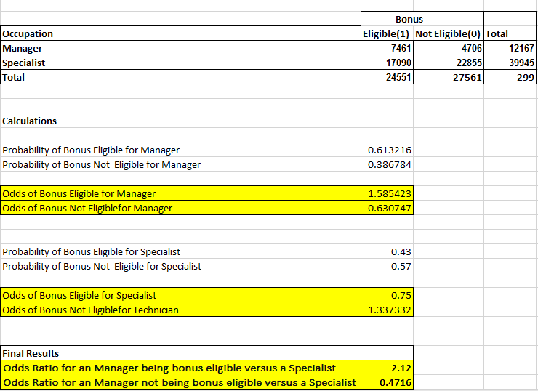
Exploratory Data Analysis Results: bonus (income >= $56,210)
The probability calculation shows that Manager has 60% eligibility for bonus , whereas specialist has only 40% eligibility for bonus.
The odds ratio shows that the odds of Manager getting bonus is 2.12 times that of specialist.
Manager is eligible to have income >= $56,220 (Median Income)
Probability and Odds Ratio Calculation:

Slide 15
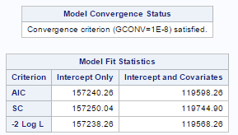
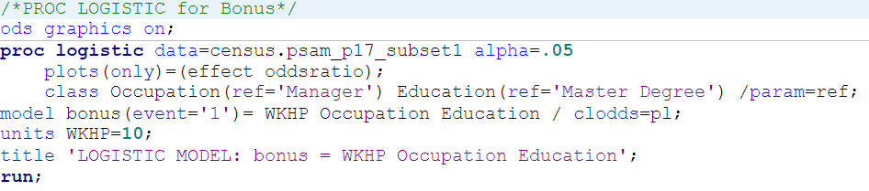
Logistic Regression Modeling Results: bonus (income >= $56,210)
Run LOGISTIC procedure to find the best fit model to predict the complex effects of interval and categorical predictors.
For every Model, the convergence criterion was met.
Comparing these models’ SC value, the model of WKHP, Occupation, Education and bonus (income >= $56,210) is better fitting.

Slide 16
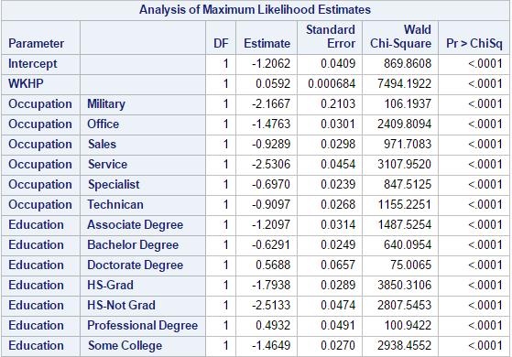
Logistic Regression Modeling Results: bonus (income >= $56,210)
This model is statistically significant, indicating all predictors in the model is useful in predicting bonus.
If you are a person who has a Master Degree and is a manger, the odds of getting the income more than $56,210 increase by 5.92% for each working 10 hours more per week.
The logistic regression equation is logit( ) = -1.2062+(0.0592)*WKHP+
(-2.1667)*Military+(-1.4763)*Office+(-0.9289)*Sales+(-2.5306)*Service+
(-0.6970)*Specialist+(-0.9097)*Technician+(-1.2097)*Associate Degree+
(-0.6291)*Bachelor Degree+(0.5688)*Doctorate Degree+(-1.7938)*HS-Grad+
(-2.5133)*HS-Not Grad+(0.4932)*Professional Degree+(-1.4649)*Some College

Slide 17
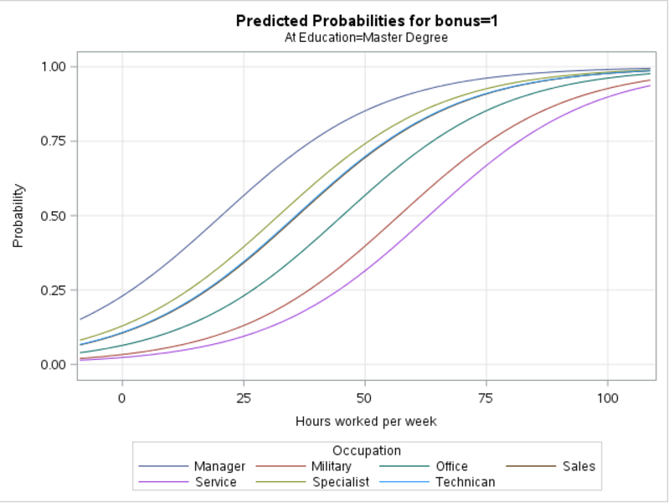
Logistic Regression Modeling Results: bonus (income >= $56,210)
For Example,
Occupation = Specialist, Education = Master Degree.
The logistic regression equation is logit( ) = -1.2062 + (0.0592) * WKHP + (-0.6970) * Specialist
The odds ratio is
e^(-0.6378) = 0.52845
Comparing the person who has a Master Degree and is a Manger, you have less chance of getting the income more than $56,210. Because, the odds ratio is only 0.52845 time for each working more 10 hours per work.

Slide 18
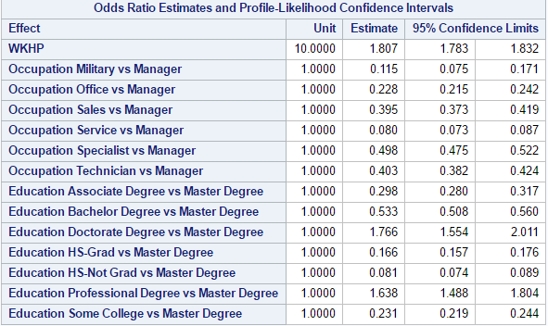
Logistic Regression Modeling Results: bonus (income >= $56,210)
The odds ratios show that, adjusting for the other predictor variables.
For example, the person with Doctorate Degree had 1.766 times the person with Master Degree to get the income more than $56,210.
Top 3 Education
Eligible for Income >$ 56,210 :
Doctorate Degree
Professional Degree
Master Degree
Top 3 Occupation
Eligible for Income >$ 56,210 :
Manger
Specialist
Technician

Slide 19
Exploratory Data Analysis Results: high_bonus (income >= $112,420)
High_Bonus is a variable created to analyze if Income>Upper Middle Class Income, then bonus eligible. Run Pearson chi-square test to examine whether there is an association between categorical variables and high_bonus (income >= $112,420)
Because the p-values of these variables for the chi-square statistic are <.0001, which is below 0.05, reject the null hypothesis at the 0.05 level and conclude that there is evidence of an association between these variables and bonus.
Cramer’s V indicates that the association detected with the chi-square test is relatively weak.

Slide 20
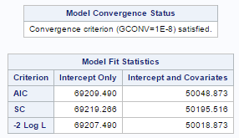
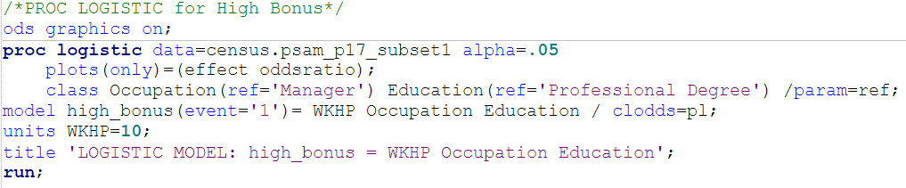
Logistic Regression Modeling Results: high_bonus (income >= $112,420)
Run LOGISTIC procedure to find the best fit model to predict the complex effects of interval and categorical predictors.
For every Model, the convergence criterion was met.
Comparing these models’ SC value, the model of WKHP, Occupation, Education and high_bonus (income >= $112,420) is better fitting.

Slide 21
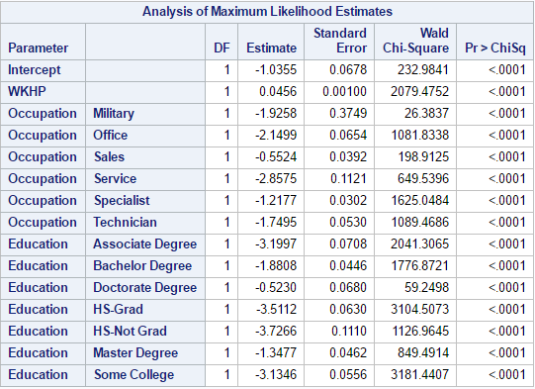
Logistic Regression Modeling Results: high_bonus (income >= $112,420)
This model is statistically significant, indicating all predictors in the model is useful in predicting bonus.
If you are a person who has a Professional Degree and is a manger, the odds of getting the income more than $112,420 increase by 4.56% for each working 10 hours more per week.
mork
The logistic regression equation is logit( ) = -1.0355 + (0.0456) * WKHP +
(-1.9258) * Military + (-2.1499) * Office + (-0.5524) * Sales + (-2.8575) * Service +
(-1.2177) * Specialist + (-1.7495) * Technician + (-3.1997) * Associate Degree +
(-1.8808) * Bachelor Degree + (-0.5230) * Doctorate Degree+(-3.5112) * HS-Grad +
(-3.7266) * HS-Not Grad + (-1.3477) * Master Degree + (-3.1346) * Some College

Slide 22
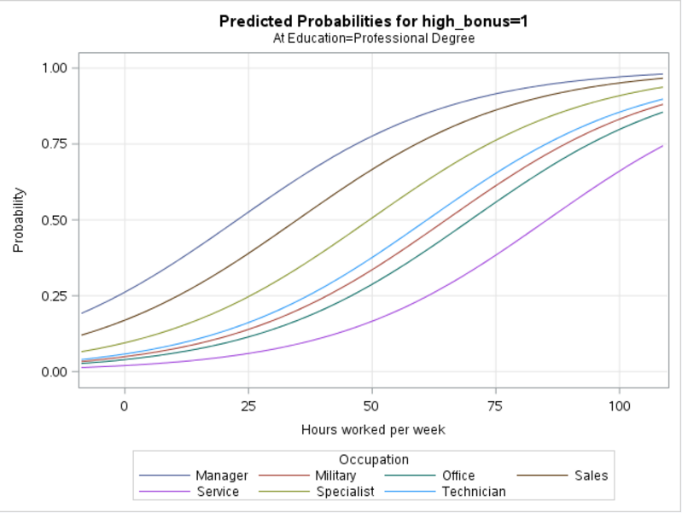
Logistic Regression Modeling Results: high_bonus (income >= $112,420)
For Example,
Occupation = Specialist, Education = Master Degree.
The logistic regression equation is logit( ) =
-1.0355 + (0.0456) * WKHP +
(-1.2177) * Specialist
The odds ratio is
e^(-1.1721)= 0.3097
Comparing the person who has a Professional Degree and is a Manager, you have less chance of getting the income more than $112,420. Because the odds ratio is only 0.3097 time for each working more 10 hours per work.

Slide 23
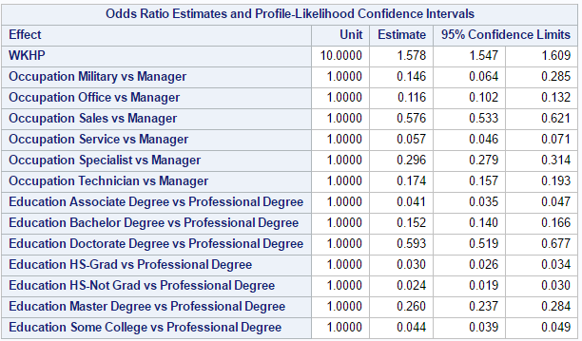
Logistic Regression Modeling Results: high_bonus (income >= $112,420)
The odds ratios show that, adjusting for the other predictor variables.
For example, the person with Doctorate Degree had 0.593 times the person with Professional Degree to get the income more than $112,420.
Top 3 Education
Eligible for Income > $112,420 :
Professional Degree
Doctorate Degree
Master Degree
Top 3 Occupation
Eligible for Income > $112,420 :
Manger
Sales
Specialist

Slide 24
Conclusions
Which predictor variables are most decisive in determining the person’s income?
There are many variables impact personal income but no one has a significant correlation with the income. Education, Occupation and Number of hours worked (WKHP) are the variables that had better impact in person’s Income. So, with the linear regression results we were able to justify the answer with the better R-square value and box plots.
Am I more likely to make more than $56,210 or $112,420 if I am a Manager or specialist?
Based on the Chi-Square test, Manager has high probability of 60% and Odds Ratio 0f 1.58. Hence, Manager is more likely to make more than $56,210 i.e. Median Income.
24

Slide 25
Conclusions
What are the top 3 degrees more likely to get income> $56,210 and $112,420?
What are the top 3 Occupations more likely to get income> $56,210 and $112,420?
Top 3 Education
Eligible for Income >$ 56,210 :
Doctorate Degree
Professional Degree
Master Degree
Top 3 Education
Eligible for Income > $112,420 :
Professional Degree
Doctorate Degree
Master Degree
Top 3 Occupation
Eligible for Income >$ 56,210 :
Manger
Specialist
Technician
Top 3 Occupation
Eligible for Income > $112,420 :
Manger
Sales
Specialist
25

